Slide 1
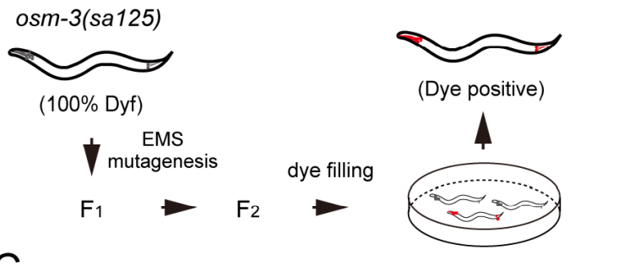
Osm-3 p802
G444E
Mapping
Whole Genome Sequencing
Phenotype II
dye-filling
Phenotype I
Compare with wildtype
And Mapping samples
~300 Single nucleotide variation due to EMS
Can focus on about ¼ length of a Chromosome

Slide 2
Screening
Screening
50-100 Samples
5-6 Samples
Sequencing
Mapping
1 month
Analyze
Sequencing
Next-gen seq is becoming cheaper
Can get a lot of allele and gene once a screen
Mapping free
Accurate and save a lot of money

Slide 3
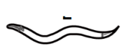
Step 1: Creat a SNP pool with SNPs have impact on amino acid
Tag
Impact SNP pool
Of Sup 1
Suppressor mutant 1
taglist
NEKL-4 SNP
SNP of all
……

Slide 4
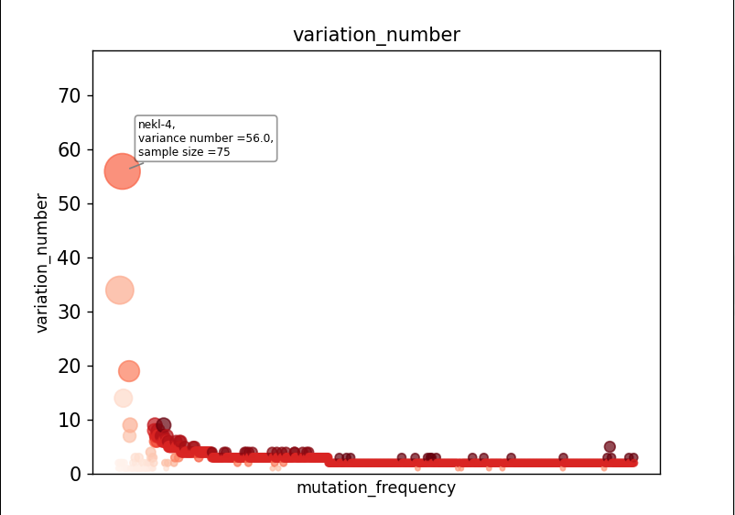
Sample size = 95

Slide 5
Step 2: Remove low possibility SNPs
Gene
Gene
Gene
1.If Nekl-4 is a suppressor
You can hardly find another suppressor
Gene In nekl-4 SNP pool
Gene
SNP Pool
Of All Input
SNP Pool
2.Because that almost all the SNPs in
SNP pool have an impact on protein
structure and amino acid. Genes linked
to the SNPs in the suppressor pool
can be considered as ‘not likely’ as well
Gene
Of Nekl-4 mutant
Gene
(intersection factor = 3%)
Problem: Impact SNP cannot be decided easily so there
might be a lot of false-negative cases

Slide 6
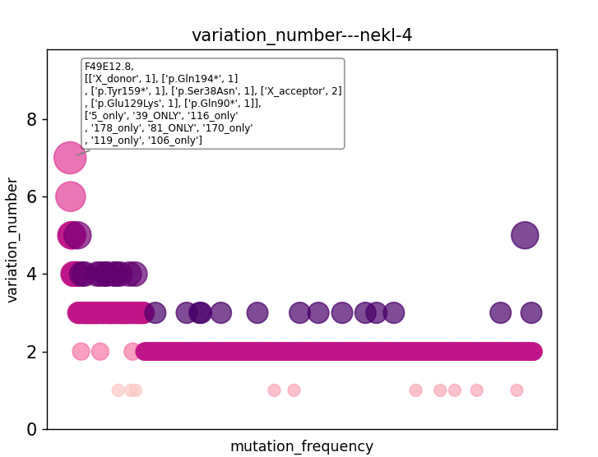

Slide 7
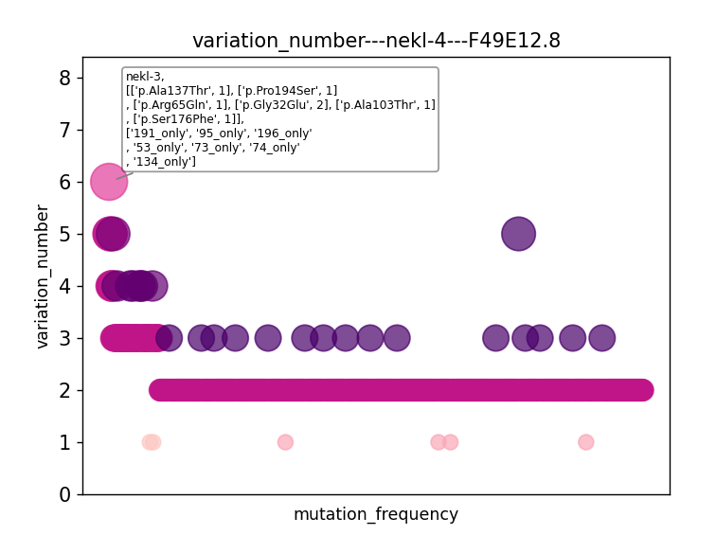

Slide 8
Using statistical model to distinguish genes
(Why suppressors can exclude each other)
Gene A= 75
If genes are randomly distributed:
Gene B = 7
c
n
95-n
P(A+,B+)=
n
P(++)
(1-P(++))
95
When suppressor screening:
H0 : B is not a suppressor
1
2
3
4
5
6
.
.
.
95
+
+
+
+
P = P(A+,B+)*P(no-sup)
+
+
+
P(no-sup)=n(no sup SNP)/(n(all SNP)-n(A SNP))
What about the P adjustment when multiple comparison?

Slide 9
To explain the reason that nekl-4 share a suppressor mutant with nekl-3
1. P(no-sup) = (9703-95)/(9703-75)
c
n
95-n
2. P(nekl-4+,nekl-3+) =
n
P(++)
(1-P(++))
95
3.P(++) = (7/95)*(75/95) = 0.0582
When one of them is no-suppressor mutation:
c
n
95-n
2. P(nekl-4+,nekl-3+) =
n
* 0.0582
* 0.9418
* P(no-sup)
95

Slide 10
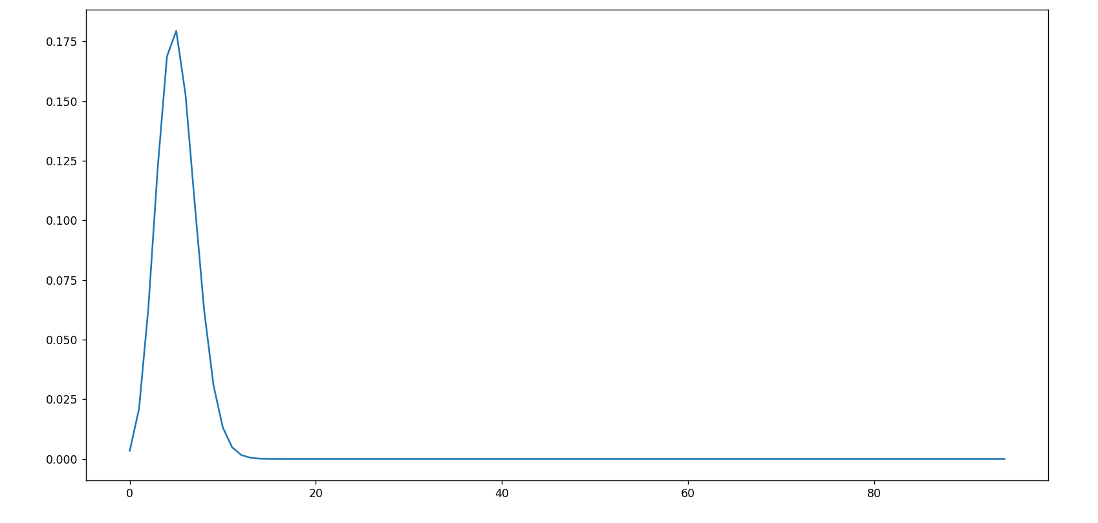
Both them are no-suppressor mutations: nekl-4(75) vs nekl-3(7)
c
n
*P(no sup)
95-n
n
P(nekl-4+,nekl-3+) =
* 0.0582
* 0.9418
95
P < 0.05: x<2.04 or x > 8.4

Slide 11
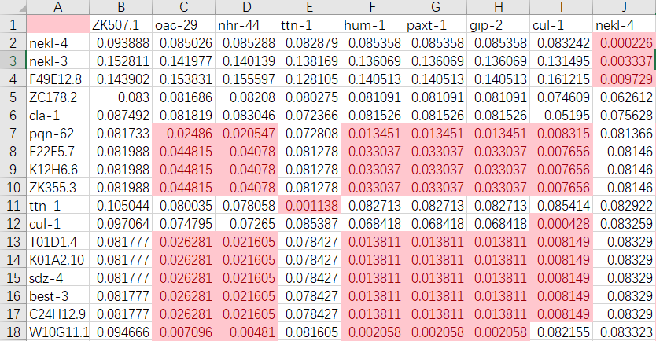
Gene to gene p value
P<0.05: n<a suppressor n>b enhancer?

Slide 12
SNP pool of
osm-3(sa125) suppressors
Unc-89
Nekl-4
ttn-1
Gene x

Slide 13
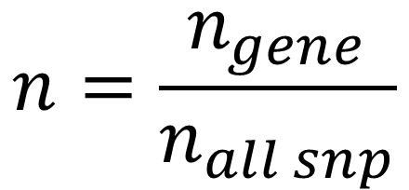
Toy data：Che-3, osm-3, unc-89, let-418
gene
Sample size
SNP number
Gene a
Gene b
Gene c
Gene d
95
98
43
175
95000
98000
43000
175000
26
5
5
3
6
2
1
1
33
32
16
45
1 (+1)
0 (+1)
0 (+1)
1 (+1)
Che-3
osm-3
unc-89
let-418
1. normalization
$$n=\frac{n_{gene}}{n_{all snp}}$$

Slide 14
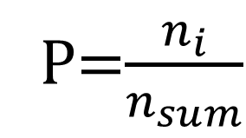
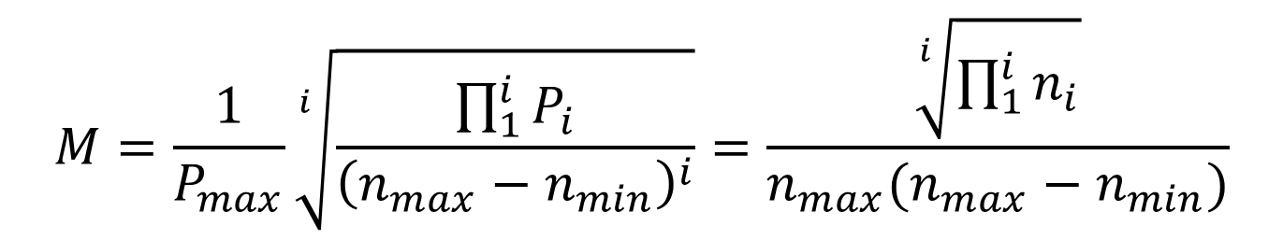
Get the M score of a gene in different screenings
$$M=\frac{1}{P_{max}}\sqrt[i]{\frac{\prod_{1}^{i}{P_{i}}}{{\left(n_{max}−n_{min}\right)}^{i}}}=\frac{\sqrt[i]{\prod_{1}^{i}{n_{i}}}}{n_{max}(n_{max}−n_{min})}$$
P=$\frac{n_{i}}{n_{sum}}$
gene
Sample size
Gene a
Gene b
SNP number
Gene c
Gene d
95
98
43
175
95000
98000
43000
175000
0.391
-
-
-
2.129
-
-
-
7.552
-
-
-
-
-
23.5
-
Che-3
osm-3
unc-89
let-418
Conclusion:
Gene a and Gene b might be the candidate of che-3 screening, Gene c and Gene d is a trash

Slide 15
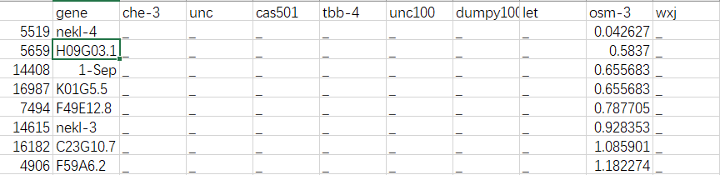
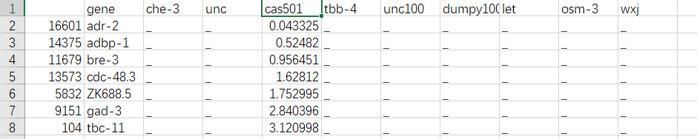
Osm-3 G444E
Dyf-5 T164E

Slide 16
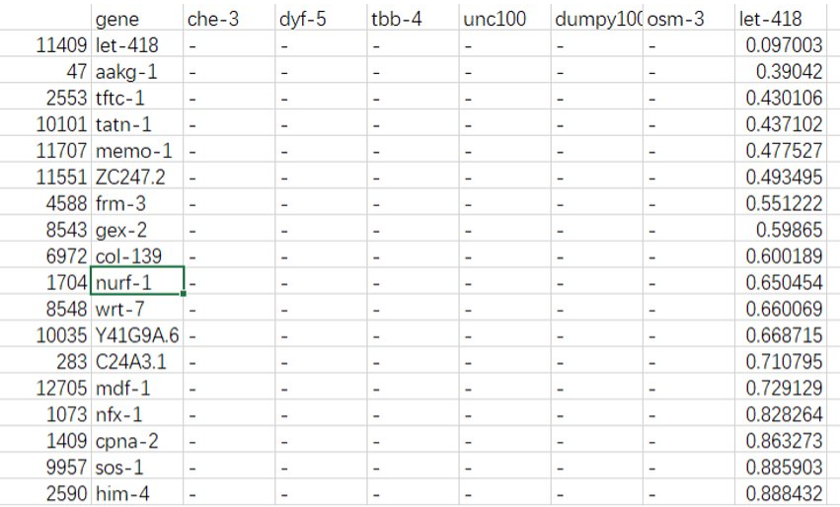
Let-418

Slide 17
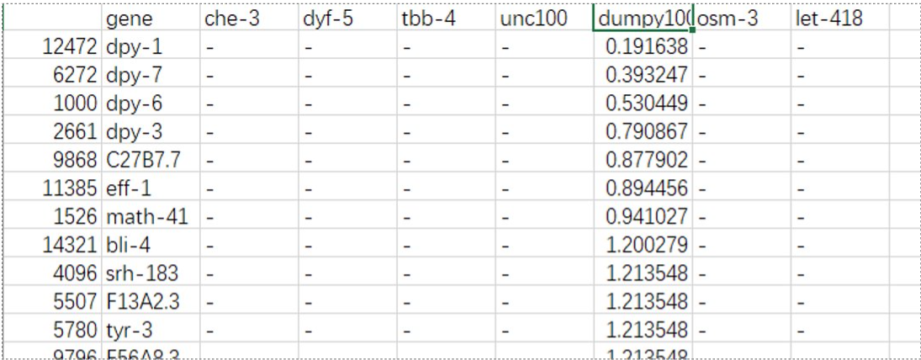
dumpy

Slide 18
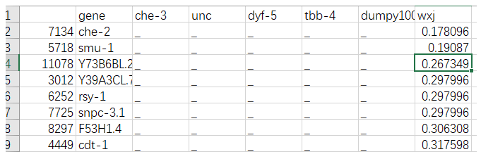

Slide 19
Unsolved problems：
Unexpected noise？
Alignmentみたいな点数システムを作りたい

Slide 20
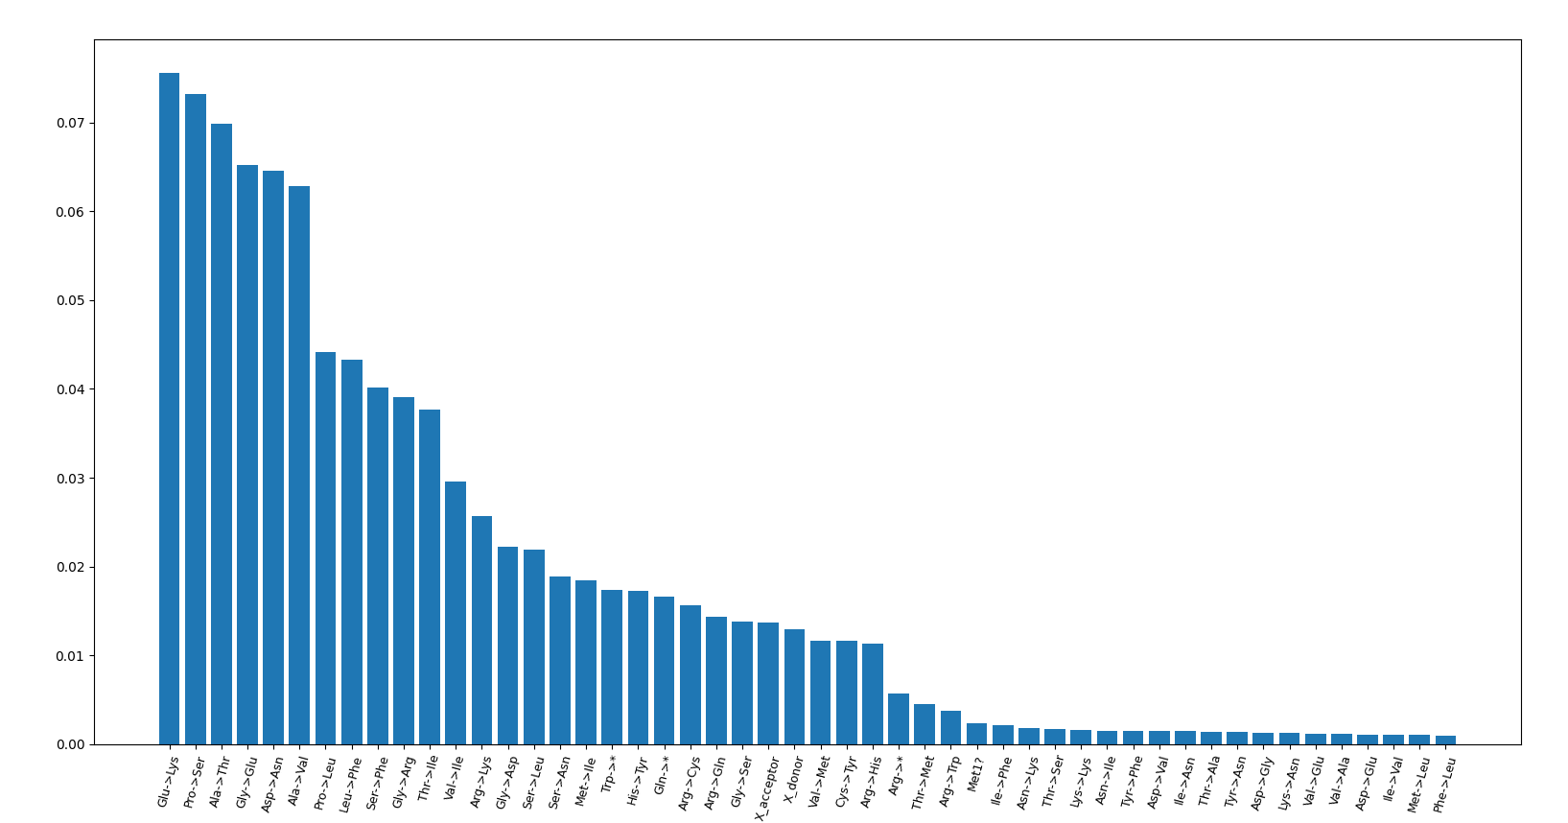
TBB-4(sa127)

Slide 21
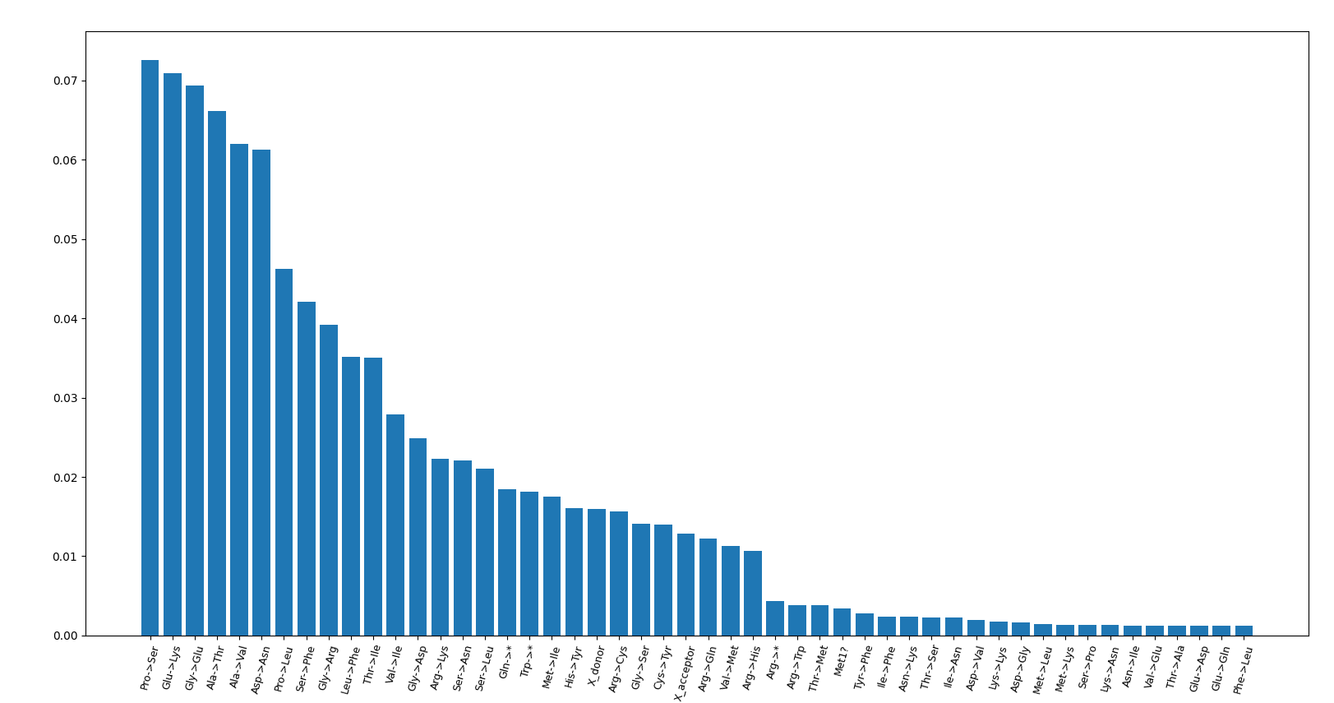
dumpy

Slide 22
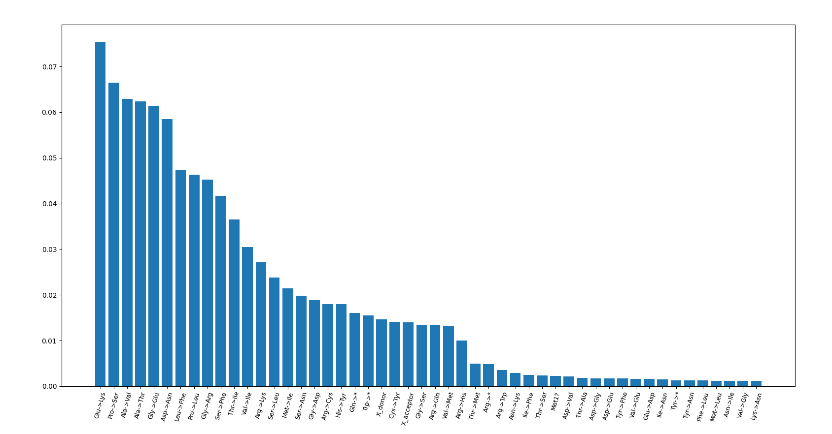
Dyf-5(cas501)

Slide 23
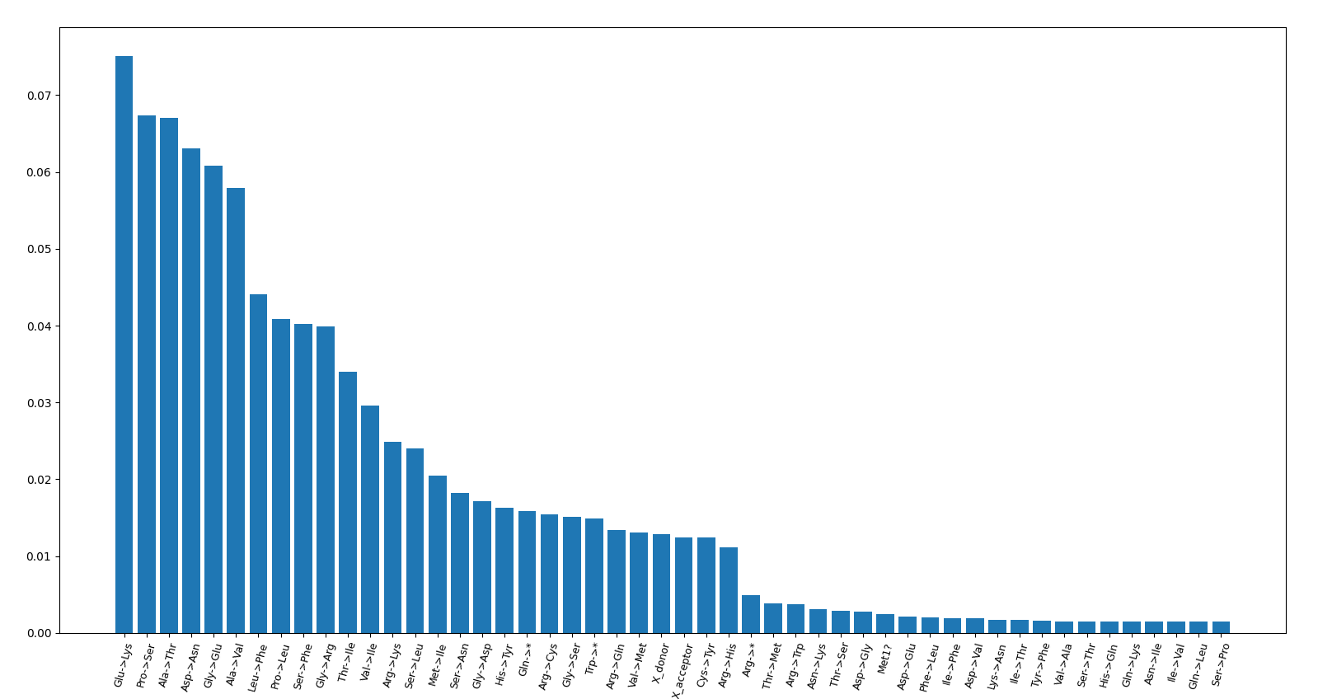
Che-3

Slide 24
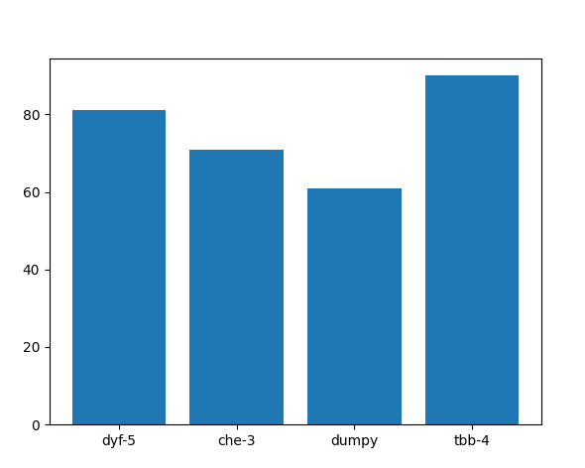
Impact mutation per sample

Slide 25
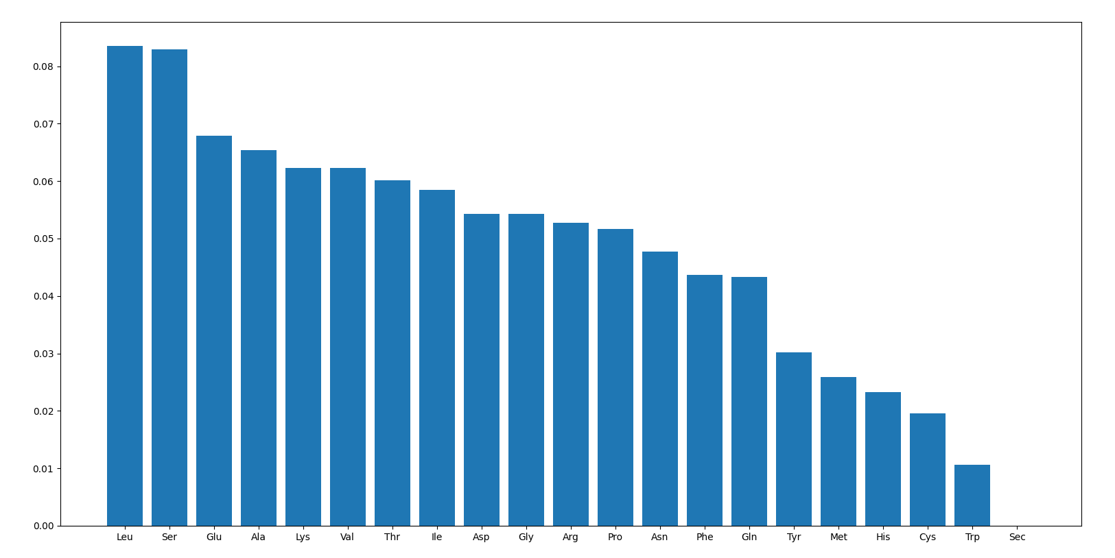
Amino acid frequency

Slide 26
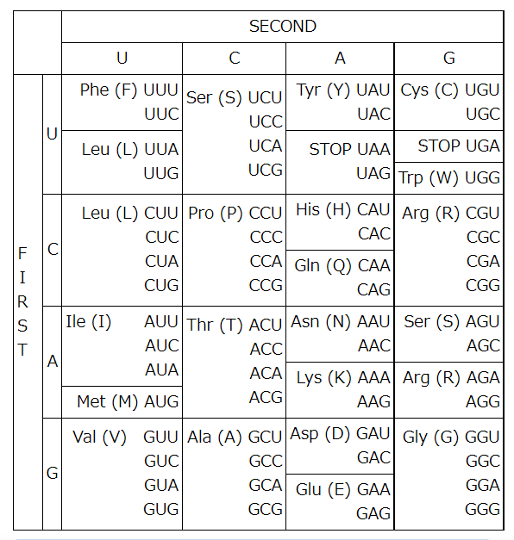
C>U or G>A

Slide 27
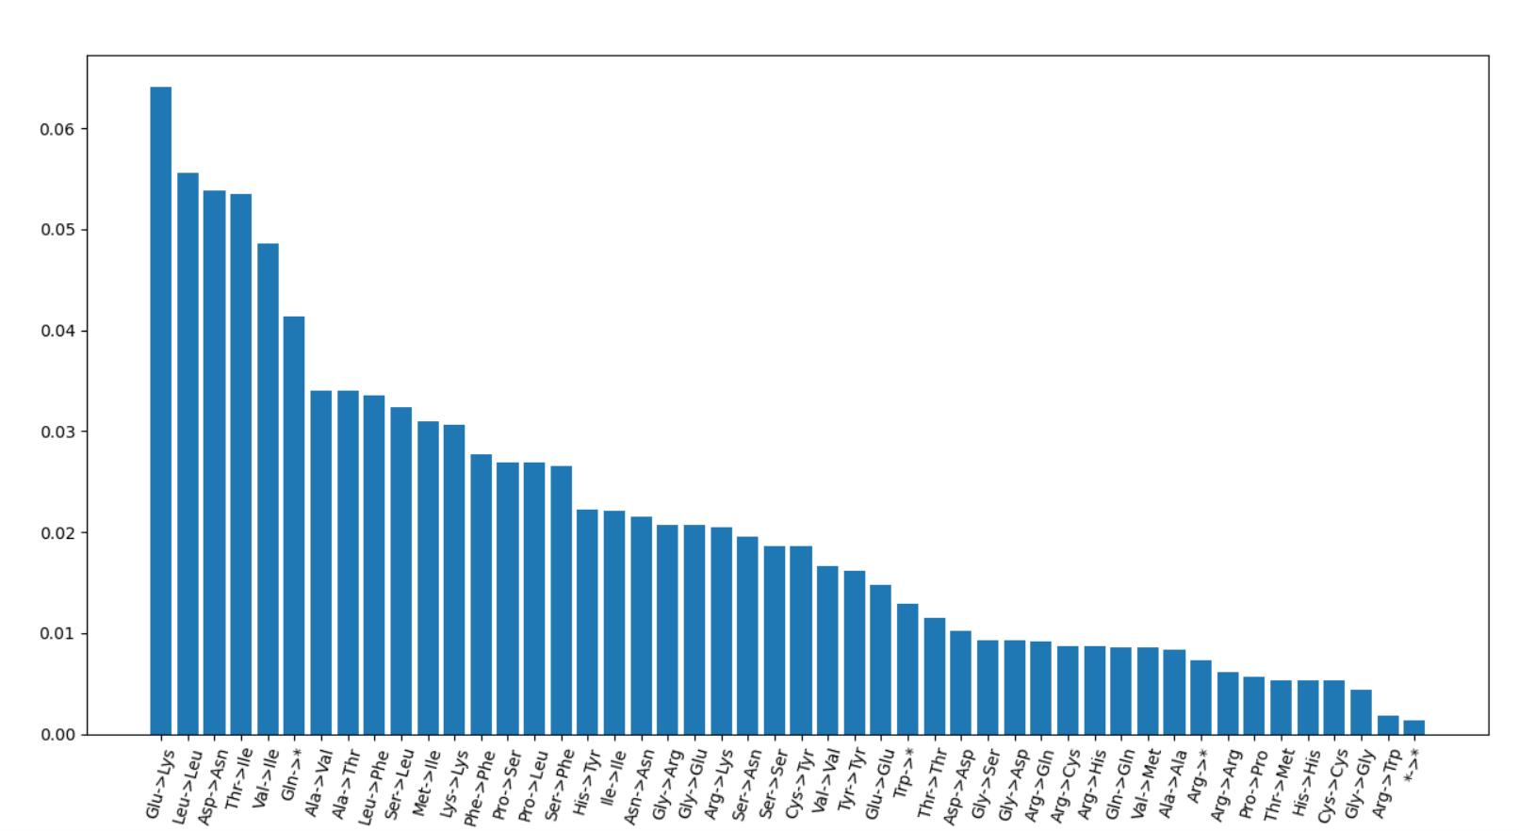
Take codon usage, amino acid count, and EMS-induced codon change into consideration
1
5
6
2
3
4

Slide 28
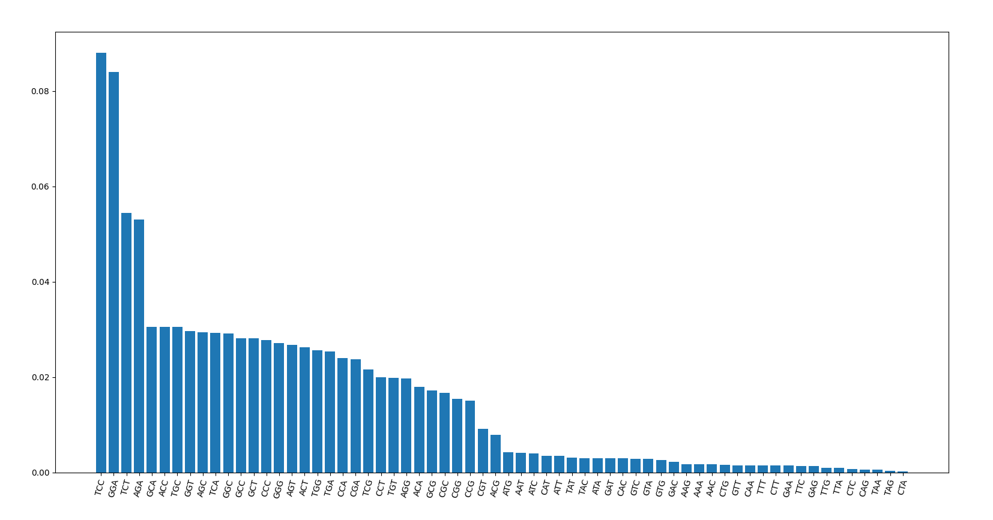
Neighbor base-pairs?
dumpy

Slide 29
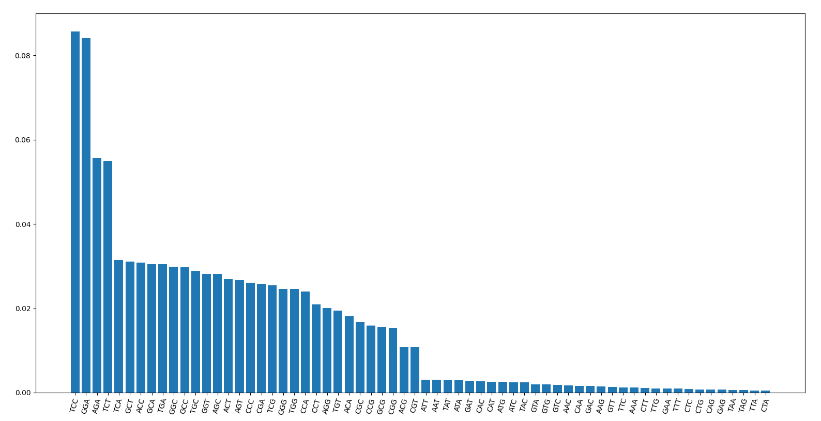
Tbb-4

Slide 30
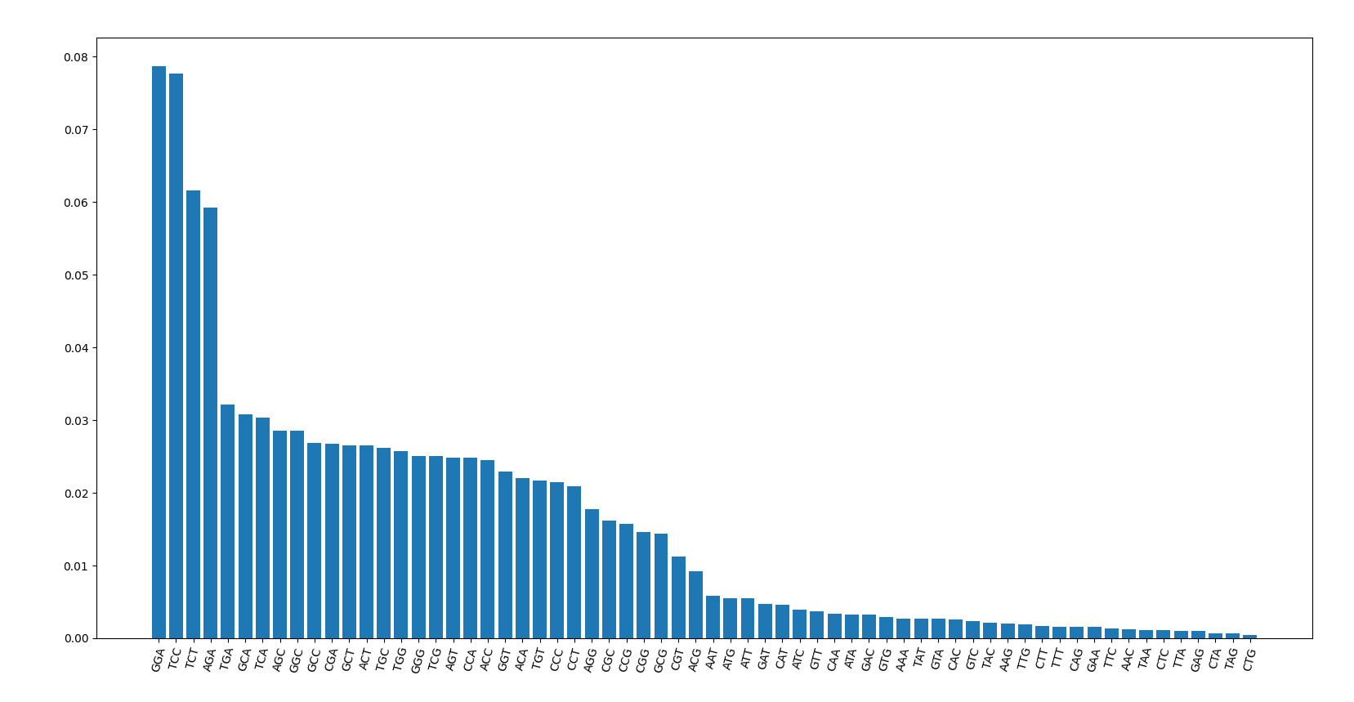
Che-3

Slide 31

Dyf-5

Slide 32
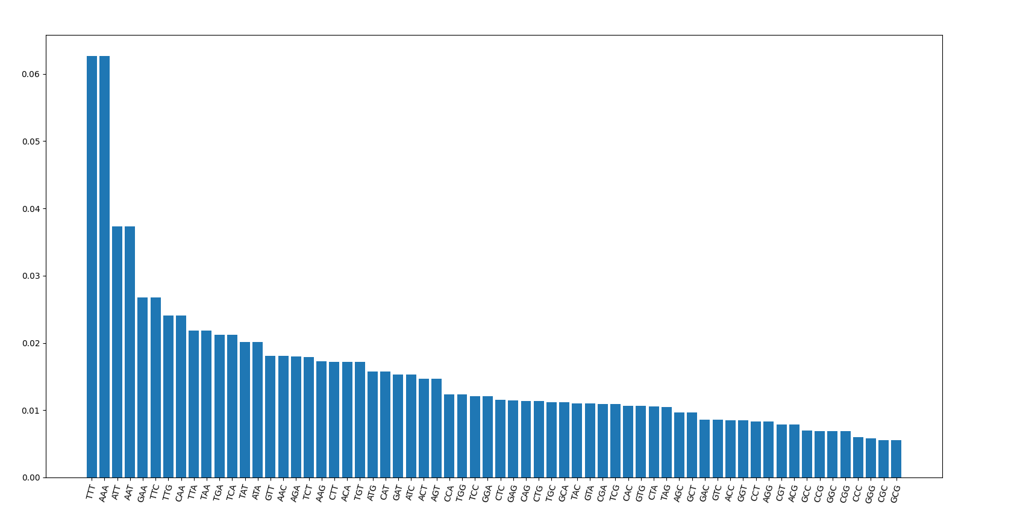
Neighbor combination of C elegans genome
TCT
AGA
TCC
GGA

Slide 33
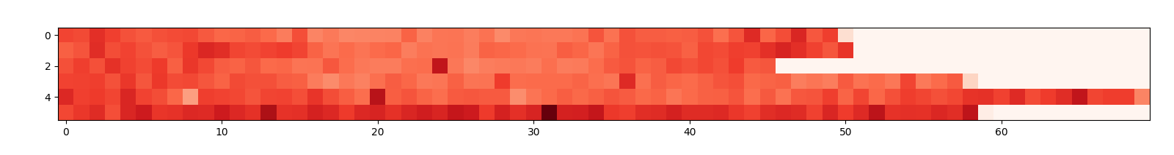
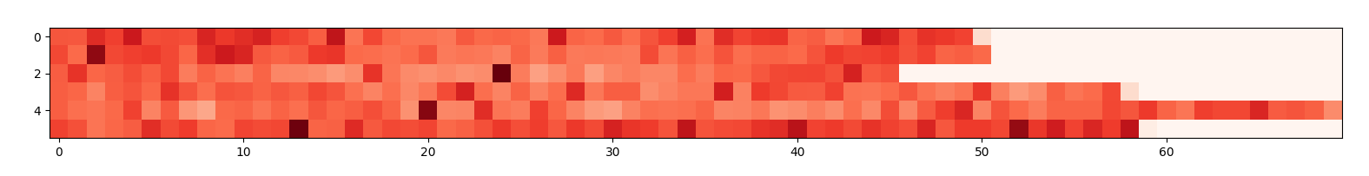
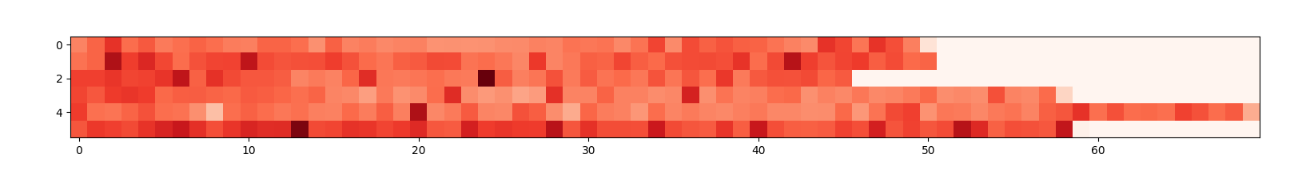
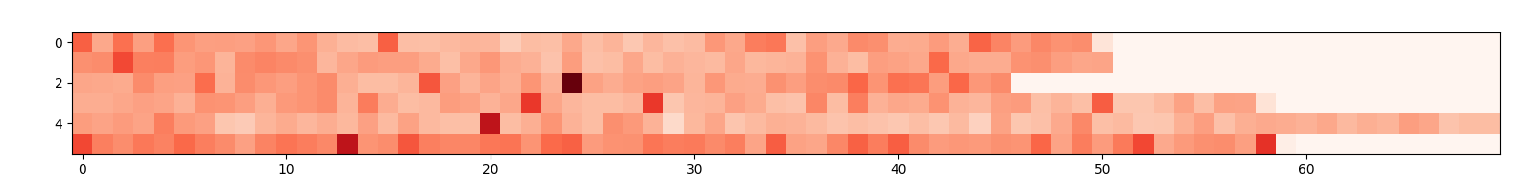
Mutation frequency per 300000 base
tbb-4 (438)
tba-5 (195)
dumpy (256)
unc (120)

Slide 34
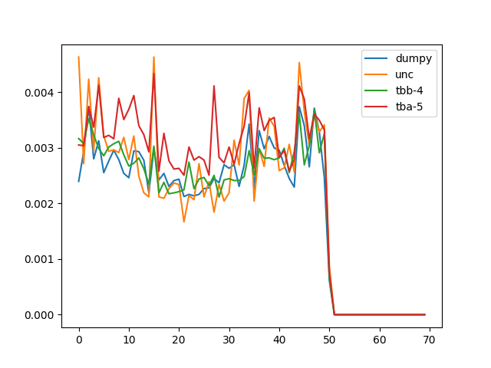
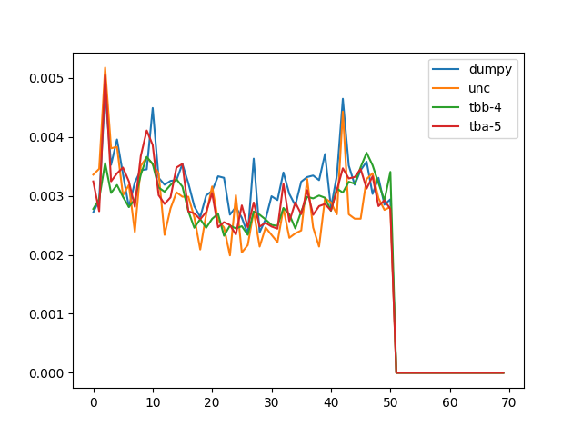
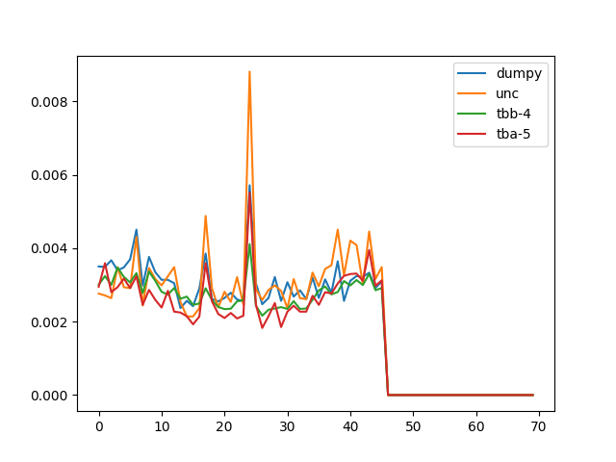
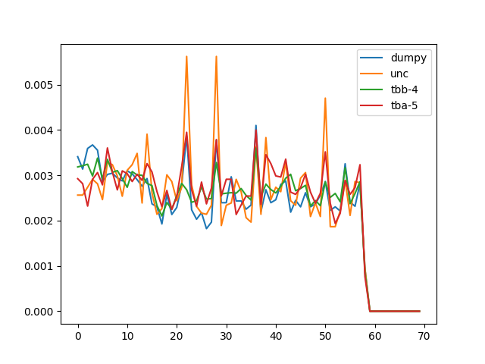
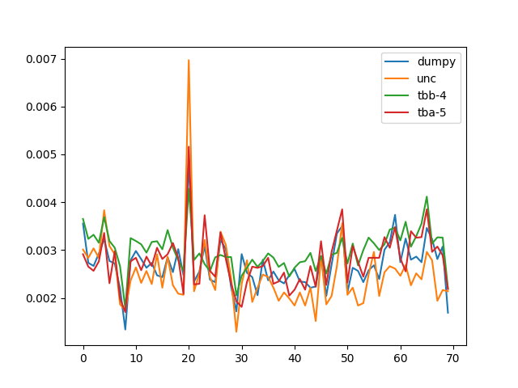
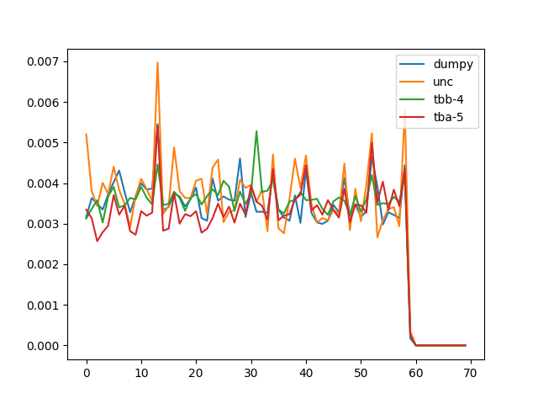
Mutation frequency per 300000 base
I
II
III
IV
V
X

Slide 35
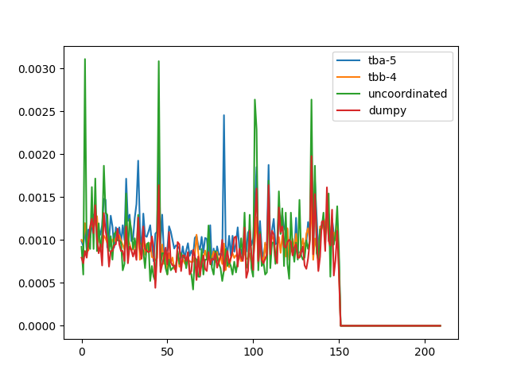
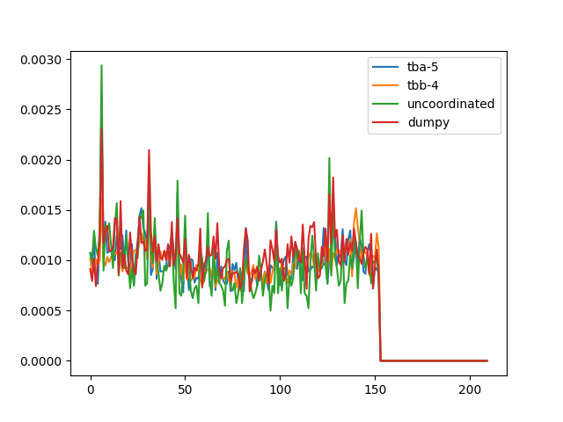
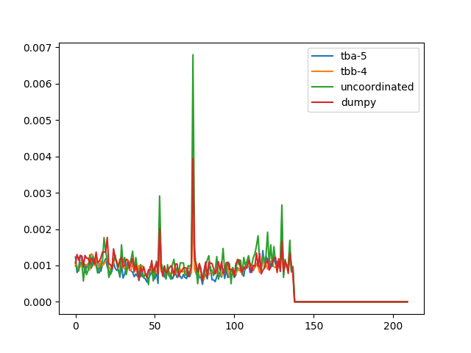
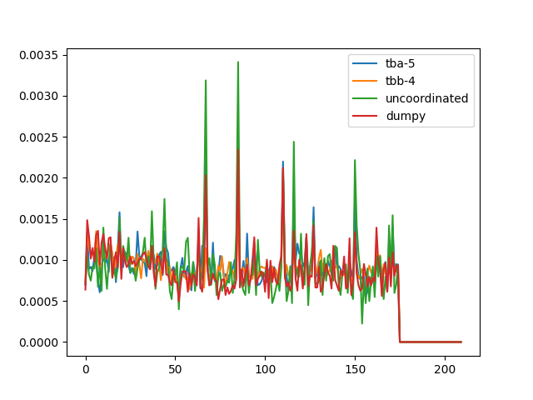
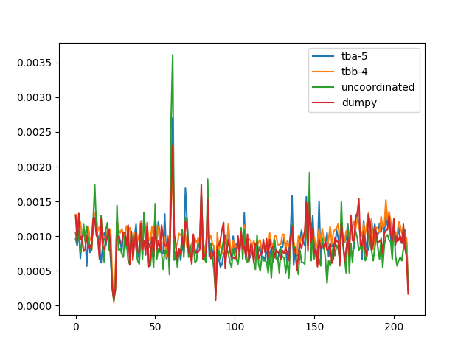
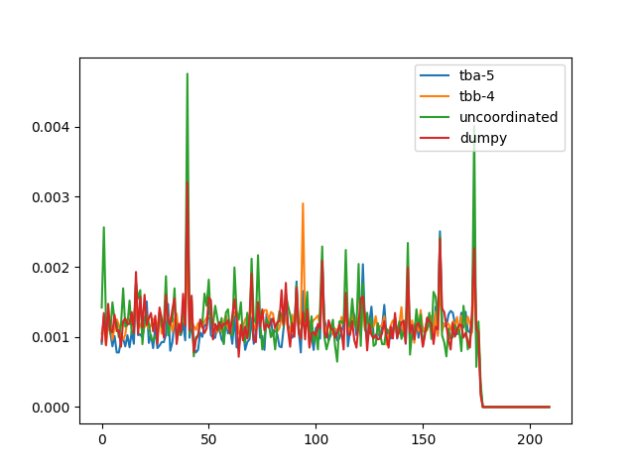
I
II
III
IV
V
X

Slide 36
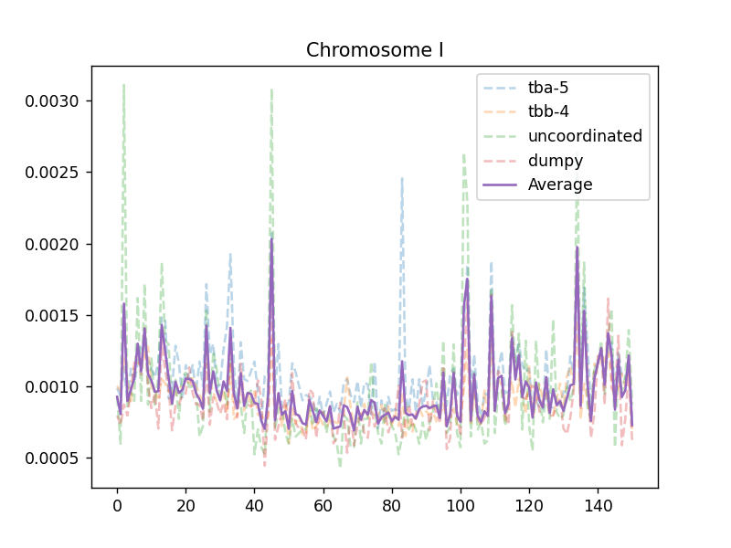
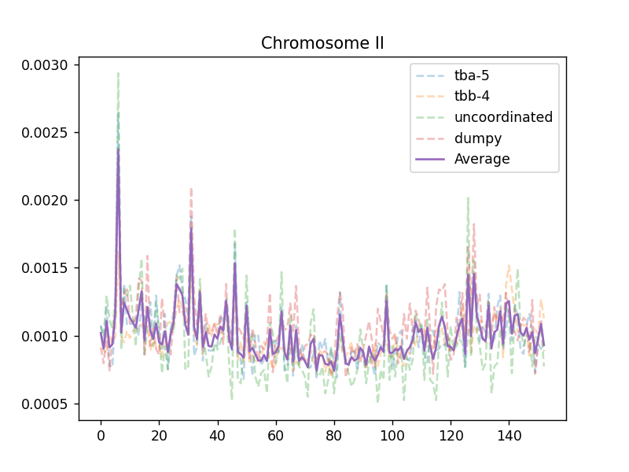
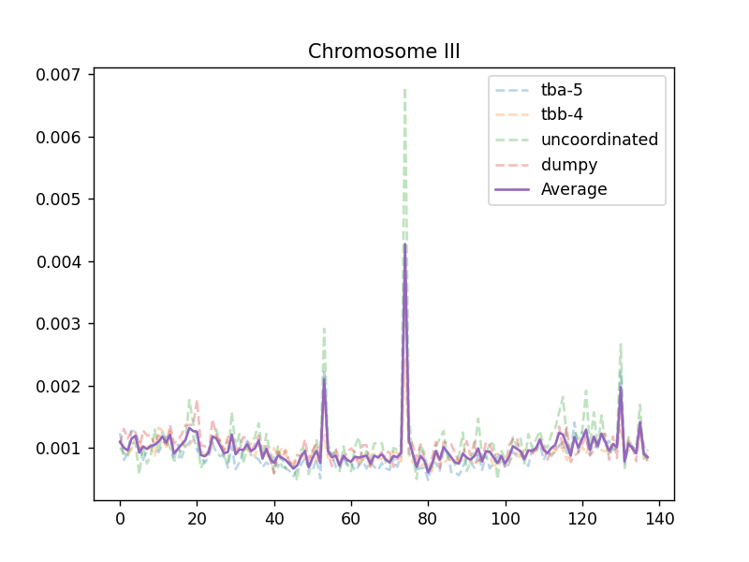
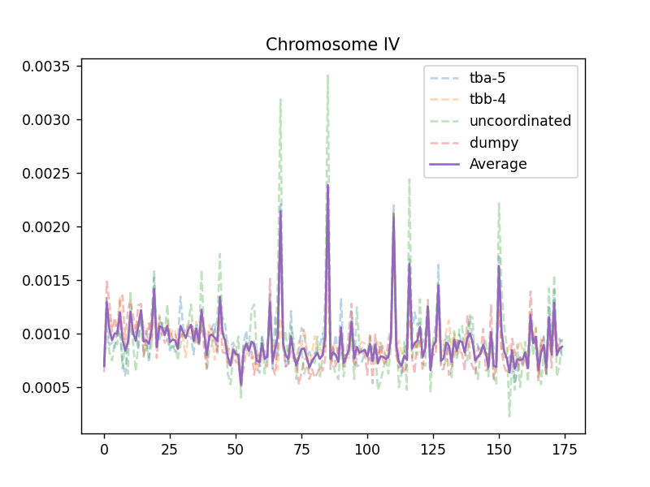
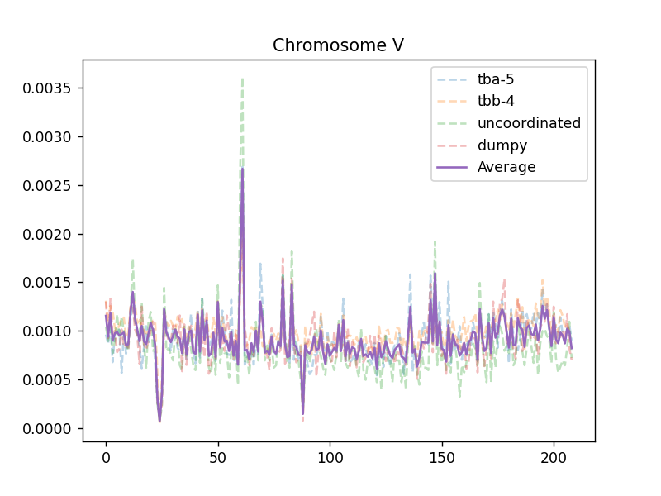
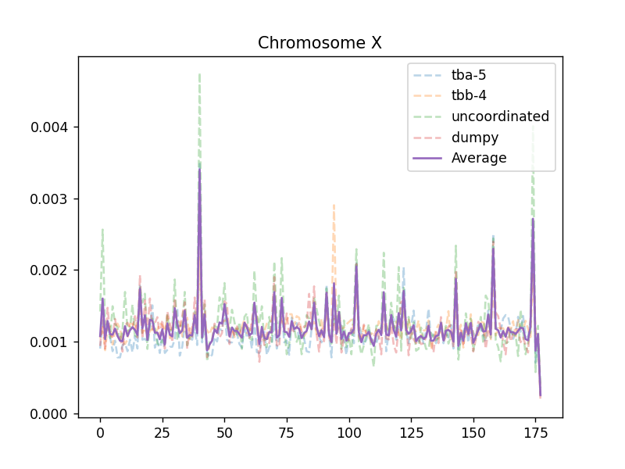

Slide 37
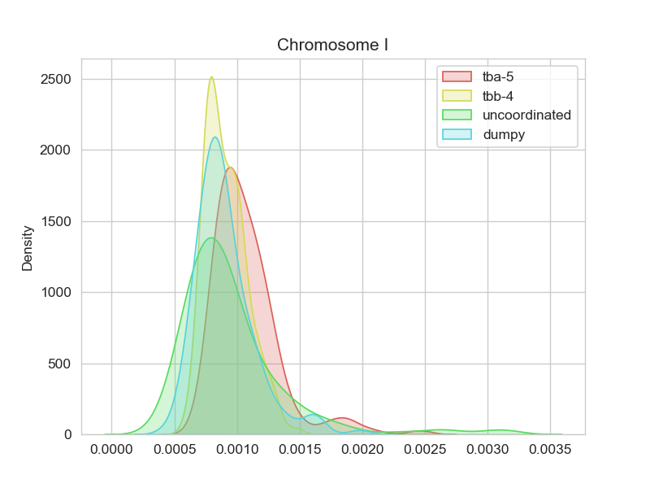






Slide 38


Std.

Slide 39


High frequency outlier
（≥Mean + std）
Low frequency outlier
（≤Mean - std）

Slide 40


High frequency outlier
（≥Mean + 2*std）
Low frequency outlier
（≤Mean - 2*std）

Slide 41

thriple-base in high freq region

Slide 42

thriple-base in low freq region

Slide 43

high-low

Slide 44

High-std

Slide 45

Low-std
Percentage of A-T,G-C

Slide 46




A/T percentage
dumpy
P(MUT)
lg(P(MUT))
A/T percentage
2
P(A/T) – 0.6
(P(A/T) – 0.6)

Slide 47


P=3.150339e-25
Spearman = -0.2286
y = -21.59x-7.587
P(MUT)
lg(P(MUT))
P(A/T) – 0.6
(P(A/T) – 0.6)

Slide 48





dumpy
‘A/T’
Poly A
Poly C
Poly A/C
exon

Slide 49


Spearman = 0.2342
p=0.2941
Spearman = 0.3434
p=1.1249e-56
mut
Poly A
Poly C

Slide 50

Spearman = -0.2155
p=1.614e-22
How to explain the hotspot/cold spot?
exon

Slide 51

Rate = mut(triple)/count(triple)

Slide 52



…ATGCGAATTGCCACT…
Code1
‘ATG’
Code2
‘TGC’
Code3
‘GCG’
Mutation rate:
r$\left[code\right]=\frac{mut\left[code\right](all genome)}{n[code](all genome)}$
$$std=\sqrt{\frac{\sum_{i=1}^{64}{{(n_{i}[code]−p_{i}[code])}^{2}}}{n}}$$
Predicted mutation:
$$p\left[code\right]=r\left[code\right]∗n[code](300,000bp)$$
Tbb-4
std
13.09

Slide 53



dumpy
dumpy
std
Tbb-4
std
tbb-4
dumpy

Slide 54




Only focus on ‘C’ and ‘G’ mutation
dumpy
Tbb-4
12.9
High variation due to genomic repair?
|Dumpy std – tbb-4 std|
G/C only

Slide 55




How many base should I use to evaluate the mutation frequency of the central base?
+ chain: exp:
A:32371810 0.32279
T:32373344 0.32280
C:17782105 0.17731
G:17759142 0.17708
Chi-square test for
each position

Slide 56

0.1769 7.7156 22.8757 28.4276 58.2035 16.9557 5.8219 2.6879
0.9812 0.0522 4.28e-5 2.95e-6 1.42e-12 7.21e-5 0.1206 0.4422
-2/-1/0/1/2 is the best pattern

Slide 57

Why triple codon?
5 –base combination also in a symmetric pattern

Slide 58


Remaining the same in different screening data
OSM-3
tbb-4
dumpy
TTN-1

Slide 59



ttn-1

Slide 60



tbb-4

Slide 61



dig-1

Slide 62



Cla-1

Slide 63



tba-5

Slide 64


How accurate can this model predict EMS mutagenesis
TBB-4 data
(Count-predicted)/predicted
accuracy
Gene length
±0.5：3173/4464 = 71.08%
±0.3：1943/4464 = 43.53%

Slide 65


dumpy data
±0.5：726/1147 = 63.30%
±0.3：473/1147 = 41.2%

Slide 66


P-val binorminal distribution padj:BH tbb-4 data
padj
Gene length
<0.05：1183/26239 = 4.51%
<0.01：559/26239 = 2.13%
<0.001：271/26239 = 1.03%

Slide 67


P-val binorminal distribution padj:BH dumpy data
padj
Gene length
<0.05：113/20160 = 0.5%

Slide 68

probability
length

Slide 69


Silent region
Chrom V:
X10^6
Consist with the TF binding activity

Slide 70


Chrom:X

Slide 71



PolII Early embryo stage
Lin-54 L3 stage
Lin-37 LTemb stage
Dumpy real data

Slide 72


Slide 73


Slide 74


Real data(dumpy)
P[code]
Pol II binding activity
a(experiment)*f(P[code])*f(Chromasome structure)*something else?

Slide 75
Machine learning
1.Data collection and preprocess for small scale test:
1.How to define the question? -- Smooth the mutation data
1. Creat a norm curve as a seed
Mean = 0.5
Std = 0.15
n = mean gap of the chromosome
Mixed gaussian model-like

Slide 76


How to define ‘High frequency region’ or ‘Silent region’

Slide 77
Feature
1.Histone modification
H3 144 L3 stage
H3K27ac early embryo
H3K27me early embryo
H3K27me L3
H3K36me3 late embryo
H3K4me3 late embryo
H3K79me mixed embryo
H4dam L3
2.Centrisome binding
HCP3 early embryo
HCP3 late embryo
3.Chromatin silencing
His-72 TILLING
Hpl-2 L3
4.Nuclear envelope interaction
LEM2 mixed embryo
5.TF binding activity
RNA Pol II average stage
Unc-39 embryo
Unc-62 embryo
Unc-62 young adult
W03F9.2
W03G10AR18
Ztf-11 embryo
6. Base bias
Smooth with a 100 base frame

Slide 78

Preprocessing of features:

Slide 79
Preprocess
1
100
150
1
100
………
-25
25
Average = 0
Average = 0.01
150
………
1
100
150

Slide 80


After smooth

Slide 81

2.Choose model
LASSO
1.Regression model
2.Classification model
Linea regression
Rigid
ACCURACY<0.2%
Elastic net
Y(mutation factor) = w1x1 + w2x2 + w3x3 + ….+ wnxn
With different restriction
Decision tree model
For example:
TF binding activity is the strongest factor
Only when the region can bind with TF
It can be accessed by other factors
To reduce the information entropy at first, I set the
Value of input -2 instead of 0 to make it easier to
be seen as a key factor
Plan B

Slide 82
Random Forest:
Randomly use different part of the input data (different feature and different sample) to build different trees,
Take the average output as the final output.
Use 80% as training set and 20% as test set separately to avoid over fitting.

Slide 83


Slide 84



Slide 85







Choose 64 estimator

Slide 86






generalization ability
Trainning set:0.2
0.3
0.35
0.4
0.45
0.5

Slide 87


Estimator = 30
Estimator = 8
predict
predict
data
data

Slide 88













Slide 89










Slide 90
The tree might be like:
HIS-27(high freq)
H3K4me3(low freq)
Important feature
W03F9.2(mid)
H3K27(low freq)
LEM2,unc-39,unc-62,Y39G10AR18,HCP3,H4Dam
Unused histone,TF data
Code
Not-so-important feature

Slide 91






Slide 92






Slide 93













Slide 94












Slide 95







Slide 96



Separate model
Whole genome model

Slide 97



Separate model
Whole genome model

Slide 98


Slide 99


Some outliers have a bad effect on this model: tbb-4

Slide 100
correct
Plan to remove outliers
result
1.Training – Predicting
2.Remove data which is not well predicted(0.1%)
3.Return to step 1
OR
Outlier because of screening selection
Remove them before training (Grubbs etc.)
400*600*2 = 480000 bases

Slide 101
もっと進んでいこうと思う方向：
１．全ゲノムモデルを作ってまず今のスクリーニングデータで確かめる
２．各染色体のモデルを作ってみます。
メリット：モデルをロードする時や学習させる時これほどの時間とメモリーをかからない
染色体によってもっと精密的な予測ができる。
デメリット：異常値に影響されやすくて、間違っているモデルを出すがもしれない。
聞かれる問題：
１．なぜこの２２種類のfeaturesを使う？
２．染色体によってモデルが異なっている原因？
R2 = 1-residue/(residue+std^2)

Slide 102


1st time de-outliers 91988000:91991000,,,,67750000:67830000

Slide 103


Slide 104
1
K-1
test
train
train
test
train
Evaluate each test
and calculate average score
train
test
train
train
test

Slide 105


Ttn-1 mutation predicted without ttn-1 in training set
20-fold test

Slide 106


Slide 107

20-fold test 500 average

Slide 108

Silented Chrom V

Slide 109

Tbb-4 mutation factor
Dpy mutation factor

Slide 110
Million mutation project Data
VC20* are EMS mutated (737 strains)
265169 SNPs in total
Some results differ from Ou Lab screening forced me to look back on these datas

Slide 111



dumpy screening ttn-1 76
Tbb-4 screening ttn-1
161
mmp
210

Slide 112




Mmp data

Slide 113




exp

Slide 114
Chi-square
****
****
****
*
**
****
****
****
****
****

Slide 115
New plan 1
1. The mistake that continuous data cannot be simply randomly divided to test and train datasets.
Using cross value test
Tree Numbers versus Tree depth

Slide 116
New plan 2
No smooth but input 0,1,2
0,0,0,0,1,2,1,1,1,2,1,0,0,0
average

Slide 117



Slide 118



Slide 119
9434452 9436893

Slide 120


7004 genes in chrom V
Mmp data
Predicted mutation factor

Slide 121


Mmp chi2

Slide 122



Slide 123


Slide 124


Average_mutation
predicted

Slide 125


Spearman = 0.23
p=1.774e-25
Spearman = 0.23
p=1.774e-25
Really happened
Really happened
PolII ChIP-seq
Predicted

Slide 126

?
Mut freq in intron is lower
Tbb : total mutation snp: 184594
intron variant: 7225
total intron length: 13780055
predict to have 25196.8 mutations
so why?
Chrom I kde plot

Slide 127
Red outliers
1.5 * IQR
0.00306919244550399
blue
0.0004136708362060475
0.00016339201829990605
Middle:7564460, low: 3760398, high: 3747572

Slide 128


Slide 129


Slide 130



5bp C/G only
7bp
7bp C/G only

Slide 131




C
G
A
T

Slide 132


Slide 133

Tbb-data with tbb

Slide 137
Estimator = 30
Estimator = 8
predict
predict
data
data

Slide 138


Slide 139





-code
-nuclear envelope
interaction
-Centrosome
-His-27
-His-27(only)
High freq formation need at least one set of these data

Slide 140


- All TF binding data

Slide 141
Discussion
2022/11/2

Slide 142
EMS screening
Osm-3 p802
G444E
Test cross and Mapping
Whole Genome Sequencing
Phenotype II
dye-filling
Phenotype I
Compare with wildtype
And Mapping samples
~300 Single nucleotide variation due to EMS
Can focus on about ¼ length of a Chromosome

Slide 143
SNP pool of
osm-3(sa125) suppressors
Unc-89
Nekl-4
ttn-1
Gene x

Slide 144
Mutation frequency per 300000 base
tbb-4 (438)
tba-5 (195)
dumpy (256)
unc (120)

Slide 145

EMS mutagenesis

Slide 146
How many base should I use to evaluate the mutation frequency of the central base?
+ chain: exp:
A:32371810 0.32279
T:32373344 0.32280
C:17782105 0.17731
G:17759142 0.17708
Chi-square test for
each position

Slide 147
0.1769 7.7156 22.8757 28.4276 58.2035 16.9557 5.8219 2.6879
0.9812 0.0522 4.28e-5 2.95e-6 1.42e-12 7.21e-5 0.1206 0.4422
-2/-1/0/1/2 is the best pattern

Slide 148
Why triple codon?
5 –base combination also in a symmetric pattern

Slide 149
ttn-1
184594:18 per 10kb

Slide 150
tbb-4

Slide 151
dig-1

Slide 152
Cla-1

Slide 153
tba-5

Slide 154
Silent region
Chrom V:
X10^6
Consist with the TF binding activity

Slide 155
Chrom:X

Slide 158
PolII Early embryo stage
Lin-54 L3 stage
Lin-37 LTemb stage
Dumpy real data

Slide 159
Real data(dumpy)
P[code]
Pol II binding activity
a(experiment)*f(P[code])*f(Chromasome structure)*something else?

Slide 160
How to define ‘High frequency region’ or ‘Silent region’

Slide 161
Feature
1.Histone modification
H3 144 L3 stage
H3K27ac early embryo
H3K27me early embryo
H3K27me L3
H3K36me3 late embryo
H3K4me3 late embryo
H3K79me mixed embryo
H4dam L3
2.Centrisome binding
HCP3 early embryo
HCP3 late embryo
3.Chromatin silencing
His-72 TILLING
Hpl-2 L3
4.Nuclear envelope interaction
LEM2 mixed embryo
5.TF binding activity
RNA Pol II average stage
Unc-39 embryo
Unc-62 embryo
Unc-62 young adult
W03F9.2
W03G10AR18
Ztf-11 embryo
6. Base bias
Smooth with a 100 base frame

Slide 162
Preprocessing of features:

Slide 163
Preprocess
1
100
150
1
100
………
-25
25
Average = 0
Average = 0.01
150
………
1
100
150

Slide 164
After smooth

Slide 165
2.Choose model
LASSO
1.Regression model
2.Classification model
Linea regression
Rigid
R2<0.002
Elastic net
Y(mutation factor) = w1x1 + w2x2 + w3x3 + ….+ wnxn
With different restriction
Decision tree model
For example:
TF binding activity is the strongest factor
Only when the region can bind with TF
It can be accessed by other factors
To reduce the information entropy at first, I set the
Value of input -2 instead of 0 to make it easier to
be seen as a key factor
Plan B

Slide 166
Random Forest:
Randomly use different part of the input data (different feature and different sample) to build different trees,
Take the average output as the final output.
Use 80% as training set and 20% as test set separately to avoid over fitting.

Slide 167
Choose 64 estimator

Slide 168
generalization ability
Trainning set:0.2
0.3
0.35
0.4
0.45
0.5

Slide 171
The tree might be like:
HIS-27(high freq)
H3K4me3(low freq)
Important feature
W03F9.2(mid)
H3K27(low freq)
LEM2,unc-39,unc-62,Y39G10AR18,HCP3,H4Dam
Unused histone,TF data
Code
Not-so-important feature

Slide 177
Separate model
Whole genome model

Slide 178
Separate model
Whole genome model

Slide 180
Some outliers have a bad effect on this model: tbb-4

Slide 181
correct
Plan to remove outliers
result
1.Training – Predicting
2.Remove data which is not well predicted(0.1%)
3.Return to step 1
OR
Outlier because of screening selection
Remove them before training (Grubbs etc.)
400*600*2 = 480000 bases

Slide 182
1st time de-outliers 91988000:91991000,,,,67750000:67830000

Slide 184
1
K-1
test
train
train
test
train
Evaluate each test
and calculate average score
train
test
train
train
test

Slide 185
Ttn-1 mutation predicted without ttn-1 in training set
20-fold test

Slide 187
20-fold test 500 average

Slide 188
Silented Chrom V

Slide 189
Problems：
How to avoid overfitting
How to remove outliers

Slide 190
Million mutation project Data
VC20* are EMS mutated (737 strains)
265169 SNPs in total
Some results differ from Ou Lab screening forced me to look back on these datas

Slide 191
dumpy screening ttn-1 76
Tbb-4 screening ttn-1
161
mmp
210

Slide 192
Mmp data

Slide 193
exp

Slide 194
Chi-square
*
**
****
****
****
****
****
****
****
****

Slide 195
Problem 2
No smooth but input 0,1,2
0,0,0,0,1,2,1,1,1,2,1,0,0,0
average

Slide 197
Ttn-1 in Tbb-4 vs ttn-1 in mmp

Slide 198


Slide 199

Tbb-4 model by seq
Tbb-4 model trained via tbb data

Slide 200
7004 genes in chrom V
SNP number
Mutation expect (n*p)

Slide 201


Almost all genes are well predicted in this model
Tbb-4 model
mmp model
SNP number
Mutation expect (n*p)
Mutation expect (n*p)

Slide 202


Genes predicted to have almost the same mutation frequency in different models.
Tbb-4
dumpy
mmp
mmp

Slide 203

Nekl-4
Osm-3 G444E screening
N = 94
Padj(-lg)
Nekl-3
F49E12.8
Fold Change (-log2)

Slide 204

tbb-4
Tbb-4 screening
N = 438
Total snp = 183323
Padj(-lg)
Y55F3C.17
Y69H2.21
Y69H2.25
tba-5
Fold Change (-log2)

Slide 205

Osm-3 G444k screening
N = 19
Nekl-4
Dyf-18
Padj(-lg)
H39E23.3
Y55F3C.17
Fold Change (-log2)

Slide 206

dpy-3
dpy-1
F40C5.2
Y69H2.21
dpy-6
dpy-8
Padj(-lg)
dpy-2
dpy-9
dpy-7
Y55F3C.17
F14F7.5
dpy-10
sre-21
dpy-13
dpy-17
mct-2
Fold Change (-log2)

Slide 207


Slide 208

abt-2
Million mutation project
N = 737
gcn-1
abts-3
Padj(-lg)
Fold Change (-log2)

Slide 209


Slide 210



Slide 211
Some important data
C/G : 0.354
Prediction >0.01(mean+2std): 5974484(0.059 of genome, 0.154 of C/G)
mutated : 78315 (0.2954)
MEAN: 0.0026
STD: 0.0038

Slide 212


Model I: predicting the EMS mutagenesis frequency
$$P_{mut}=α_{0}f(x)$$
genome
ATGGACCAATTA………AATTAGGCAATCCAGG
Pentabase bias
Histone modificcation
For prediction
All Features
……
…………
Mutation number
00100100000 …………00000100000010
Model II: predicting the EMS accessbility
$P=αf\left(x\right)∗P_{0}$
genome
ATGGACCAATTA………AATTAGGCAATCCAGG
Histone modificcation
……
Calculation
Of
Feature importance
Chromosome
Features
…………
$$\frac{n}{P_{0}}$$

Slide 213



Genome scanning evaluation: compare the prediction to actual data every 300000 bp.
Base bias
Model II
Model I

